Slide 1
Title:
Loglens-Simplified security log analysis (SIEM-Lite tool)
Presented by:
Name-Shrija Sujit Chalke
Course-Cyber security
Email id - shrijachalke@gmail.com

Slide 2
Project Overview
Modern web servers generate huge volumes of log data that record every request made to the server. These logs act as digital evidence of system activity and potential cyber-attacks.
However:
Logs may contain millions of entries daily.
Manual analysis is impractical.
Security threats can remain hidden.
LogLens is developed to automate this process by transforming raw logs into meaningful security insights.
LogLens is a lightweight SIEM-like tool designed to analyze web server log files automatically. Instead of manually inspecting millions of log entries, the system:
Parses raw logs.
Detects cyber-attack patterns.
Aggregates results.
Displays insights via a dashboard.
It answers: Who attacked, how, and when.

Slide 3
Problem Statement
Problem:
Organizations face several challenges in log analysis:
Massive log size (GBs per day).
Unstructured text format.
Difficulty identifying malicious patterns.
Lack of real-time insights.
Attack attempts may go unnoticed.
Security teams need automated insights.
Solution: LogLens automates log parsing, threat detection, and visualization.

Slide 4
Objectives
The main objectives of the LogLens system are:
To automate web server log analysis
To extract structured data from raw logs
To detect common web-based attacks
To identify malicious IP addresses
To visualize attack patterns and trends
To handle large log files efficiently
To assist system administrators in threat monitoring

Slide 5
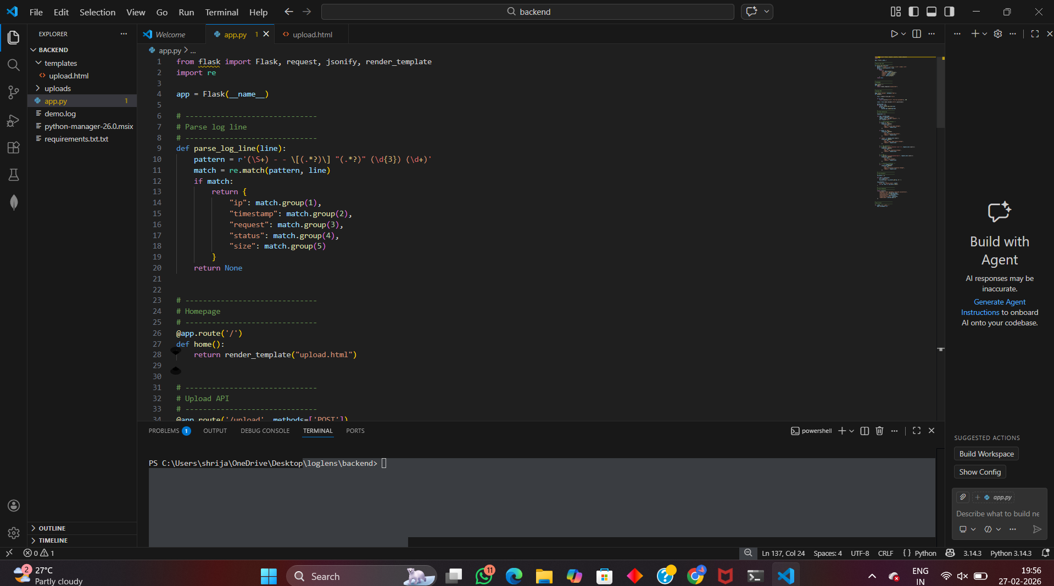
Step 1- Project folder structure

Slide 6
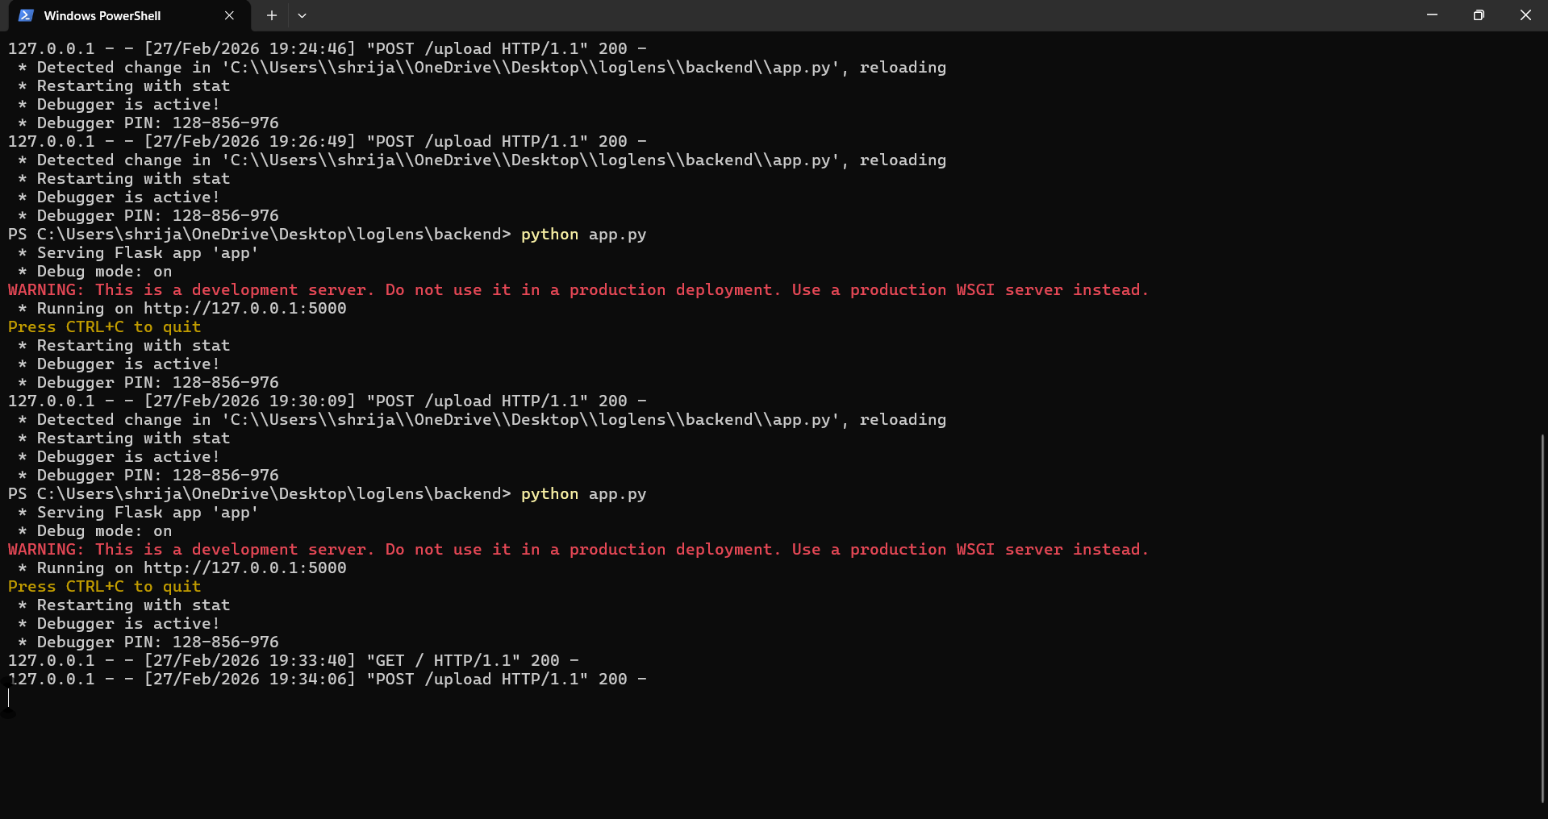
Step 2- Running flask server

Slide 7
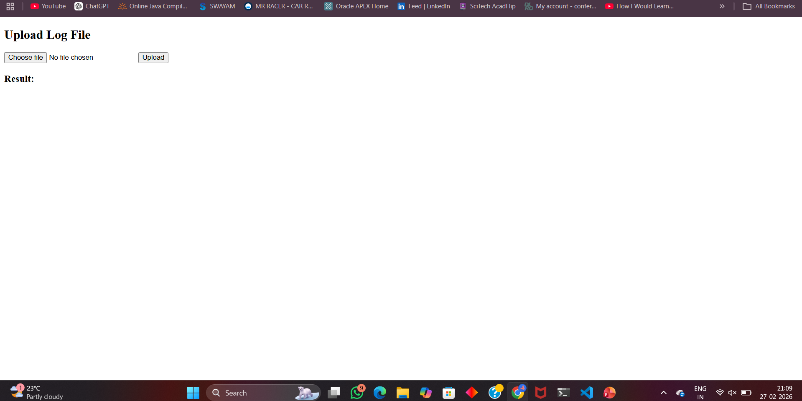
Step 3- Log file upload interface

Slide 8
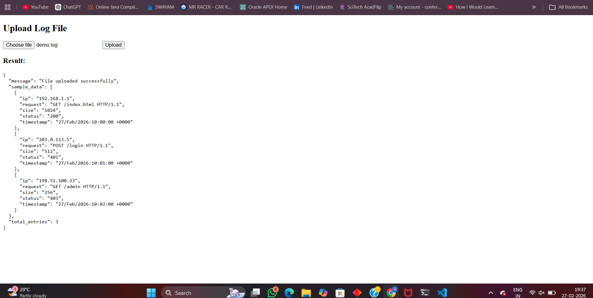
Step 4- Threat detection output

Slide 9
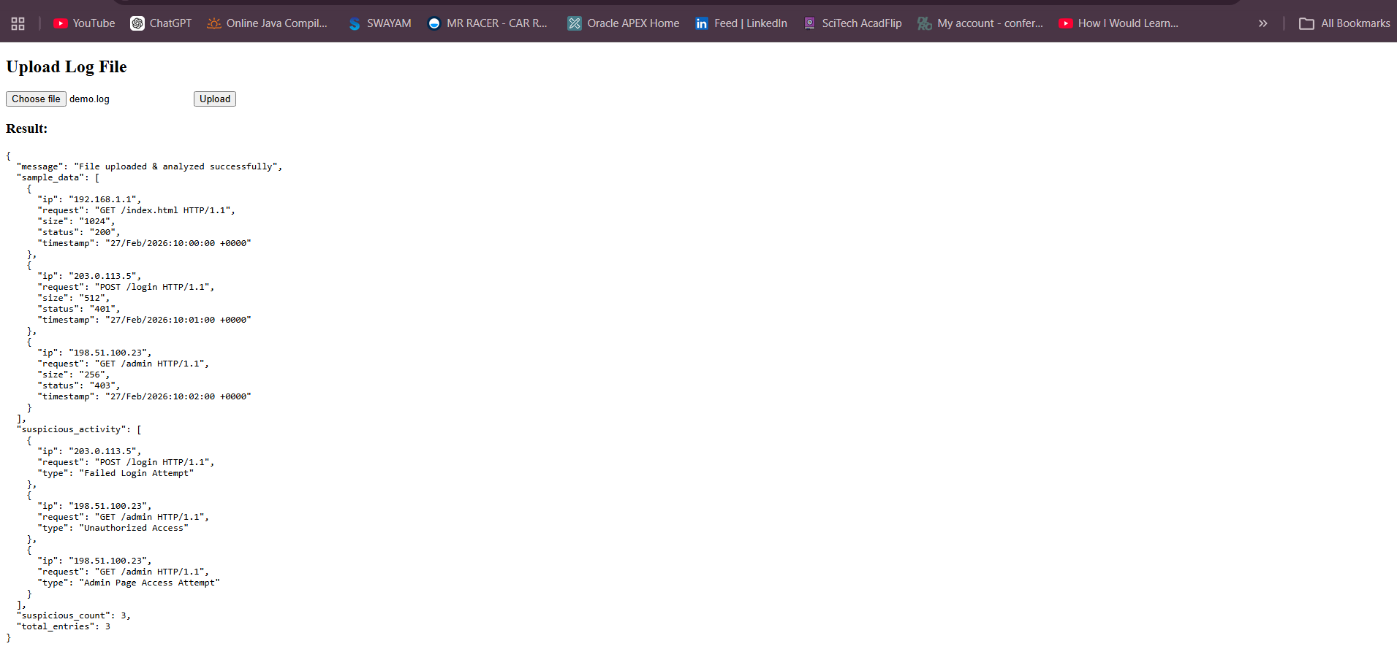

Slide 10
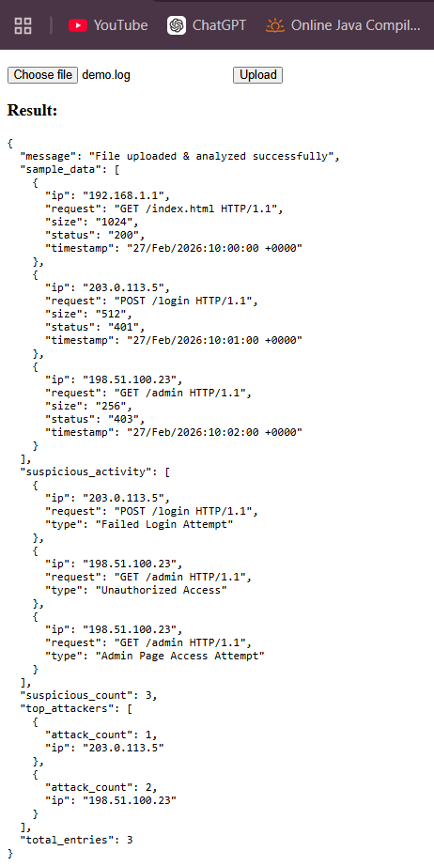
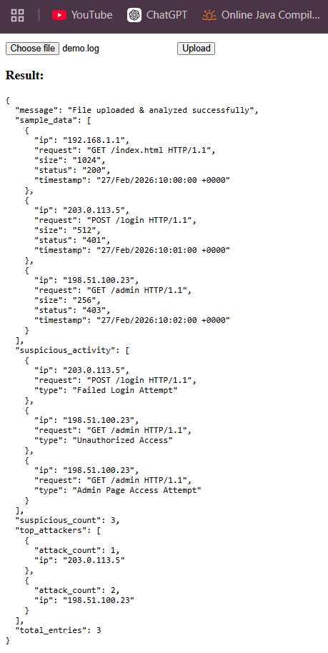

Slide 11
Tools and technologies used
Programming Languages
Python / Node.js — Backend processing
JavaScript — Frontend logic
Frameworks
Flask / Express — Backend API
React.js — User interface
Libraries & Utilities
Regular Expressions (Regex) — Pattern matching
Pandas — Data processing (if Python used)
Recharts — Data visualization
Databases & Resources
Attack Signature Database (JSON)
GeoIP Database (MaxMind)
Development Tools
GitHub — Version control
Browser — Application testing

Slide 12
Methodology
The development of LogLens was carried out in a structured and systematic manner. The system was designed using modular architecture to ensure scalability, maintainability, and performance efficiency.
Phase 1: System Design
Analyzed project requirements and defined system objectives.
Designed the architecture consisting of Parser Engine, Threat Detection Engine, and Analysis Module.
Decided to use backend processing to handle large log files efficiently.
Phase 2: Log Parsing
Implemented a file upload interface to accept .log files.
Used Regular Expressions (Regex) to parse Common Log Format (CLF).
Extracted structured fields such as:
IP Address
Timestamp
HTTP Method
Request Path
Status Code
Response Size
Converted unstructured log lines into structured JSON format.
Phase 3: Threat Detection
Created a database of attack signatures using Regex patterns.
Compared each parsed log entry against known attack patterns.
Detected:
SQL Injection attempts
Cross-Site Scripting (XSS)
Directory Traversal
Brute Force login attempts
Tagged suspicious entries with attack type and severity.

Slide 13
Phase 4: Data Aggregation & Analysis
Counted suspicious activities per IP address.
Identified top attackers based on frequency.
Generated summarized statistics including:
Total log entries
Suspicious count
Attack categories
Phase 5: Optimization
Implemented line-by-line processing instead of loading entire file.
Ensured efficient memory usage for handling large files.
Used backend processing to prevent browser crashes.

Slide 14
Conclusion
LogLens successfully demonstrates how automated log analysis can significantly improve security monitoring and threat detection.
The system transforms large, unstructured web server logs into structured, meaningful security insights.
By combining parsing, pattern recognition, and data aggregation techniques, LogLens identifies malicious behavior such as SQL injection, unauthorized access attempts, and brute-force attacks.
The project highlights the practical implementation of SIEM concepts in a simplified environment, making it an effective academic and real-world learning tool.

Slide 15
Step-by-Step Short Recipe of how I Achieved This:
Studied web server log structure (Common Log Format).
Designed the system architecture (Parser → Detection → Analysis).
Built backend using Flask for file upload and processing.
Implemented Regex-based log parsing.
Extracted structured data from raw logs.
Created attack signature patterns for threat detection.
Scanned parsed logs against attack signatures.
Identified suspicious activities and counted attack frequency.
Generated summarized results including top attackers.
Optimized performance using line-by-line processing.
Tested the system using sample log files.
Verified detection output and captured screenshots.

Slide 16
Thank-you!

